Slide 1

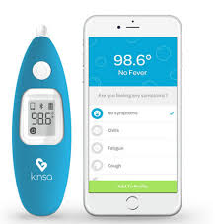












Streaming added
Amazon DynamoDB
AWS Lambda
Amazon SNS
Streaming
Real time alerts
Kinesis Streams
Users
HR DB
Kinesis Analytics
Advanced
Analytics
Batch
Amazon Redshift
ICRES DB
Kinesis Firehose
Files
Ad-hoc
Analysis
Corporate Data Center
Amazon S3

Slide 2

Amazon QuickSight

